Slide 1

Full Stack Architecture

Slide 2
What is Full Stack?
Whenever you’re surfing websites or using any web-based applications, you’re actually enjoying the benefits of a number of technologies. These applications have multiple layers, each of which is responsible for a particular job. These layers or tiers are together called a stack. Generally, there are three distinct layers – presentation layer, logic layer, and data layer.

Slide 3
The presentation layer helps you interact with the site, read information, watch videos and images, and make decisions. For example, whenever you surf a website, the page that you interact with, the fonts, images, videos, and content form part of the cosmetic layer of the website. This is accomplished with the help of HTML, CSS, and JavaScript.

Slide 4
The logic layer or the back end helps programmers create a dynamic connection between the cosmetic layer and the database. So, every time you use a filter function or use the search bar on a website, it’s actually the logic layer that transmits your requirements to the database and brings back answers.

Slide 5
Lastly, the data layer is where all the information is stored. You can probably think of it as a huge warehouse for information. The data layer comprises of the database which acts as a repository, storing and capturing information from the front-end, through the logic layer. As a Full Stack Developer, you should be capable of planning how data is stored, fetched or optimized at the backend.
Generally, you can easily focus on any one of these layers and be a front-end developer, back-end developer or a database administrator.

Slide 6
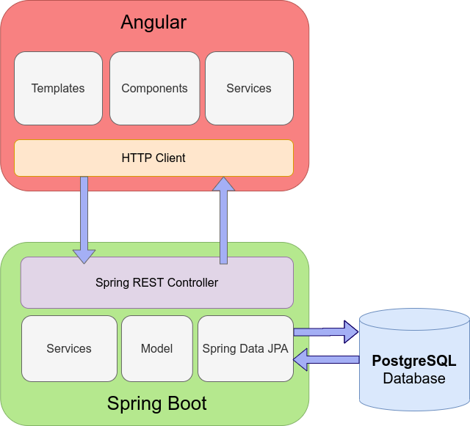

Slide 7
What is Angular?
Angular is a platform and framework for building single-page client applications using HTML and TypeScript. Angular is written in TypeScript. It implements core and optional functionality as a set of TypeScript libraries that you import into your apps.

Slide 8
What is Spring Boot?
Spring Boot is an open source Java-based framework used to create a micro Service. It is developed by Pivotal Team and is used to build stand-alone and production ready spring applications.

Slide 9
Data Base Layer
The final layer of the stack is the database. The choice of the database will depend upon your back-end (Oracle , MYSQL, MongoDB etc) The database stores all the information from your application. But that is not all that this layer does.

Slide 10
Who is a full stack developer?

Slide 11
A full stack developer is one who has skills of back-end, front-end and mobile development. They are in massive demand from companies because they work in diverse web development projects and can use their skills and expertise with both front-end and back-end language. Furthermore, they also are skilled in software testing tools.

Slide 12
A Java Full Stack Developer is a developer who has expertise and deep knowledge of frameworks and tools used in Java full stack development like Core Java, servlets, APIs, database, web architecture, etc. A Full Stack Java developer can build whole Java applications including front end, back-end, database, APIs, server and version control.

Slide 13
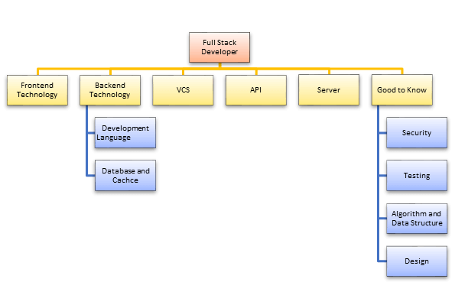

Slide 14
Advantages of Full Stack Developer
Full stack developer helps you to keep every part of the system running smoothly
Full stack developer can provide help to everyone in the team and greatly reduce the time and technical costs of team communication
If one person plays different roles, it saves your company's personnel, infrastructure and operational cost

Slide 15
Disadvantages of being a full stack developer
- Under productivity and time management
The first disadvantage is that if a company relies on just one or two full-stack developers, it may lead to several tasks piling up over a certain period of time. Therefore, It could also lead to unproductivity and bad time management.
- Not able to keep up with the trends
A full stack developer generally works across different processes, fields and skills. Therefore, it is a challenge for them to keep up-to date with the latest development trends, tools and technologies.
- Confusion about their responsibilities
In full stack development team, a developer tends to take too much workload. As a result, they forget to divide their workload into smaller tasks. Therefore, they tend to get confused about their responsibilities in a certain project.

